Slide 1

ICNC~FSKD 2009
Title: Models of distributed and collaborative Computational Intelligence
Abstract: Computational Intelligence (CI) has emerged as a sound, comprehensive and a highly synergistic environment that supports the development and analysis of intelligent systems. The successfully established synergy of neural networks, Granular Computing (and fuzzy sets, in particular) and evolutionary optimization becomes an ultimate forte of the CI.
Title: Intelligent Transportation Systems in Taiwan
Title: Exploring Constraint Partitioning and Their Applications In Natural Computations
Title: Searching an unsorted database in quantum computers

Slide 2

A Class Core Extraction Method for Text Category
Shicai Yu, Jianxing Zhang

Slide 3
Outline
Introduction
Class Core Extraction
Categorization algorithm
Experiment evaluation

Slide 4
Abstract
Text categorization is an important research field within text mining.
A document is often full of class-independent “general” words which many documents and class share.
Inspired by human cognitive procedure in text classification task, we propose a novel approach called Class Core Extraction method to extract “core” terms from each class.
“lottery” algorithm is proposed, which use weighted matching strategy to make final categorization decision.

Slide 5
Introduction
Text Categorization is a kind of pattern classification, in which the input patterns are unstructured texts. This also implies that the uniqueness of text categorization lies in its semantics-oriented characteristics.
Before classifying the documents, we should make a representation for the text, through which computer can make accurate calculation and measurement.

Slide 6
A phenomenon
When we classify some documents into the predefined categories manually, should we try to read and comprehend a text?
In most cases, we just catch some keywords or phrases without knowing the whole meaning the text and we think that they are enough to make a decision which category it belongs to. If not enough, then we’ll read several sentences to capture more info which enable use to make to correct judgment.
Being enough to use

Slide 7
Class Core Extraction
The ideal of Class Core Extraction base on such a hypothesis: there exist domain concept spaces in humans’ minds; different spaces have very different domain concepts, which domain concept spaces correspond to category concept spaces.
In natural language, words are used to represent concepts. If words which represent those domain concepts can be found, the task of text categorization can also be done by computers automatically.

Slide 8
Class Core Extraction
It is easy to understand that the words belong to a certain domain must be very distinguishable from the ones belong to others. We call these words “class core”.
Definition 1: A class core is a set composed of the terms which have great distinguishing power from certain class. We use the sign Core_{j} as a representation of the core of class c_{j} , c_{j} ∈C={c₁,c₂,…,c_{n}}, where N is the number of classes.

Slide 9
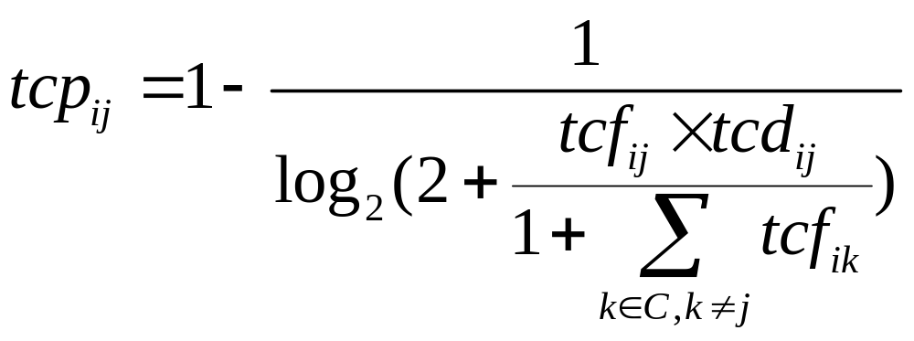
Class Core Extraction
We give a new term weighting method which describes the term’s contribution power to each class.
tcpij: the ith term’s contribution power to class cj;
tcfij: the frequency of term i in class cj;
tcdij: the number of documents in class cj where term i appears;

Slide 10
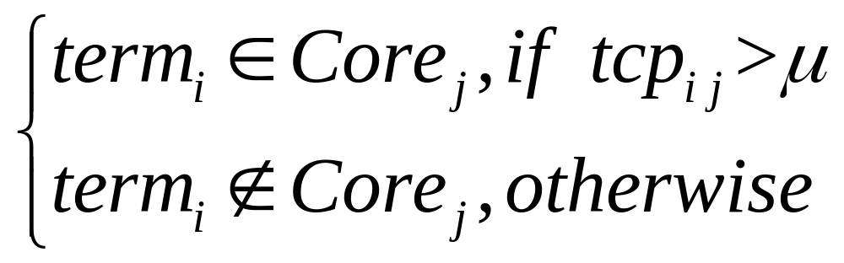
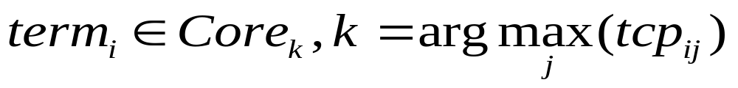
Less frequent terms in the class should have less distinguishing power.
Highly frequent terms in the class should have higher distinguishing power, unless they are also very frequent in other classes or they appear in a very small fraction of the documents in the class.
Each class will acquire a set of words as its core if they satisfy the following condition.
if one word belongs to two or more cores.

Slide 11
In our experiment, we find that some documents due to lack of core words,, are resulted wrong classification in testing phase if only use words.
To address the problem, we adopt the combination strategy.
We find that, a certain word may be ambiguous and less distinguishable when it appears independently. But is combination with other words witnesses a strong distinguishing power. Take the word “virus” as an example, there may be many different things you can imagine. Given the combination of “computer virus”, the conclusion must be changed, because its meaning has been limited. And the combination also gains more distinguishing power of IT domain rather than biological domain.

Slide 12
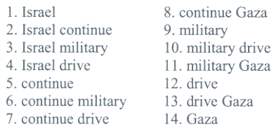
In practice, we use sliding window to implement.
“ Israel continues its military drive into Gaza”
“Israel, continue, military, drive, Gaza”
set the size of window to 4 and the combination size to 2.
Every term is a candidate to contest the qualification of being core term equally according to its contribution power computed by formula1.

Slide 13
Categorization algorithm
For a test document, each terms can be viewed as a stake, and its frequency is the number of the stake. Use terms to match every class core. If one term appears in a particular class core, it wins corresponding class bonus by a weighting strategy.
The document is classified to the category in which it wins the most bonuses.

Slide 14
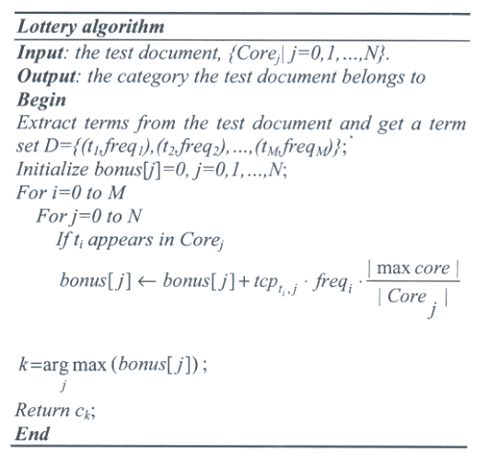

Slide 15
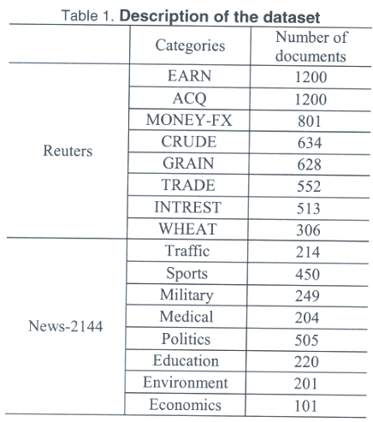
Experiment evaluation

Slide 16
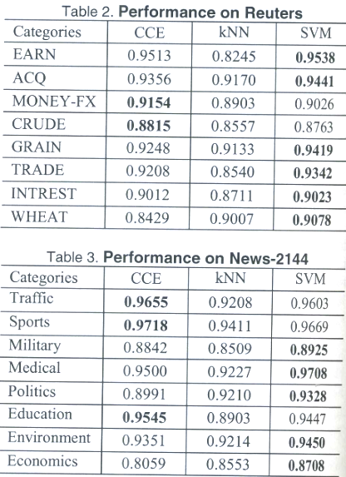
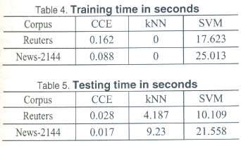

Slide 17
Conclusion
presented a new efficient Class Core Extraction method for text classification.
CCE ignores those “general” words which do not benefit to classification task and extract the real effective terms with strong distinguishing ability to construct different class cores.

Slide 18
Thanks~

